Slide 1
Design of Control Unit
The Control Unit is classified into two major categories:
Hardwired Control
Micro-programmed Control
Hardwired Control: The Hardwired Control organization involves the control logic to be implemented with gates, flip-flops, decoders, and other digital circuits. The image shows the block diagram of a Hardwired Control organization.
A Hard-wired Control consists of two decoders, a sequence counter, and a number of logic gates.
An instruction fetched from the memory unit is placed in the instruction register (IR).
The component of an instruction register includes; I bit, the operation code, and bits 0 through 11.
The operation code in bits 12 through 14 are coded with a 3 x 8 decoder.
The outputs of the decoder are designated by the symbols D0 through D7.
The operation code at bit 15 is transferred to a flip-flop designated by the symbol I.
The operation codes from Bits 0 through 11 are applied to the control logic gates.
The Sequence counter (SC) can count in binary from 0 through 15.

Slide 2
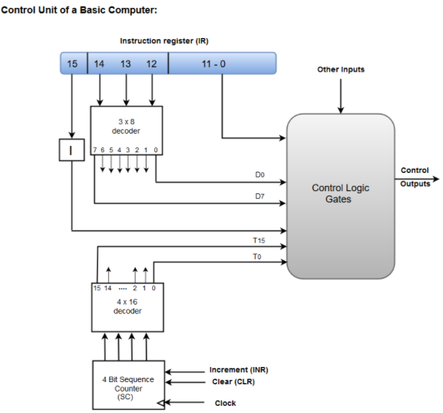

Slide 3
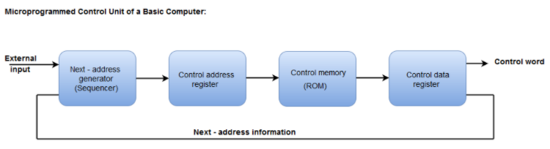
Micro-programmed Control
The Micro-programmed Control organization is implemented by using the programming approach.
In Micro-programmed Control, the micro-operations are performed by executing a program consisting of micro-instructions.
The following image shows the block diagram of a Micro-programmed Control organization.
The Control memory address register specifies the address of the micro-instruction.
The Control memory is assumed to be a ROM, within which all control information is permanently stored.

Slide 4
The control data register holds the microinstruction fetched from the memory.
The micro-instruction contains a control word that specifies one or more micro-operations for the data processor.
While the micro-operations are being executed, the next address is computed in the next address generator circuit and then transferred into the control address register to read the next microinstruction.
The next address generator is often referred to as a micro-program sequencer, as it determines the address sequence that is read from control memory.

Slide 5
